Slide 1
Scooping
Martin Chan, Fiona Gillespie, Hannah Kim
Final Presentation for 6.4210 Fall 2022: Robotic Manipulation

Slide 2
Outline:
Existing Work
Approach
Geometric scooping
Teleop record and playback
Results
Hurdles and Helps

Slide 3
Existing Work
Trajectory optimization scooping (Dexai) from lecture
Little academic work in scooping
Precompute then Choose approach
Notes:
There is a growing field of robots in kitchen applications, such as with Dexai Robotics’s Alfred (\href{https://www.dexai.com/meet-alfred}{dexai.com/meet-alfred}), which uses trajectory optimization scooping capabilities. The Toyota Research Institute (TRI) has also done work on food preparation, including simulations with hydroelastic modeling of spatulas scooping up carrot-like objects (and other shapes) off a table. Spyce, a Boston-based startup by MIT graduates, operated a restaurant in Boston with a robotic kitchen. They’ve since been acquired by sweetgreen.
To the best of our knowledge, there is no existing academic publication on scooping with a concave tool by robots. The closest we could find was \href{https://ieeexplore.ieee.org/document/9470942}{Scooping Manipulation Via Motion Control With a Two-Fingered Gripper and Its Application to Bin Picking}, a paper published July 2021 \cite{scoopy_paper} which examined the act of scooping a small flat object (such as a coin) off a table with a thin flat spatula.
We were told by Russ Tedrake that some prior approaches to scooping involved pre-computing appropriate trajectories for different bin states (such as empty, half-full, full) then using perception to determine which trajectory to select. This was the direction that we hoped to bring our project, though we did not get far enough for the perception selection process.

Slide 4
Approach

Slide 5
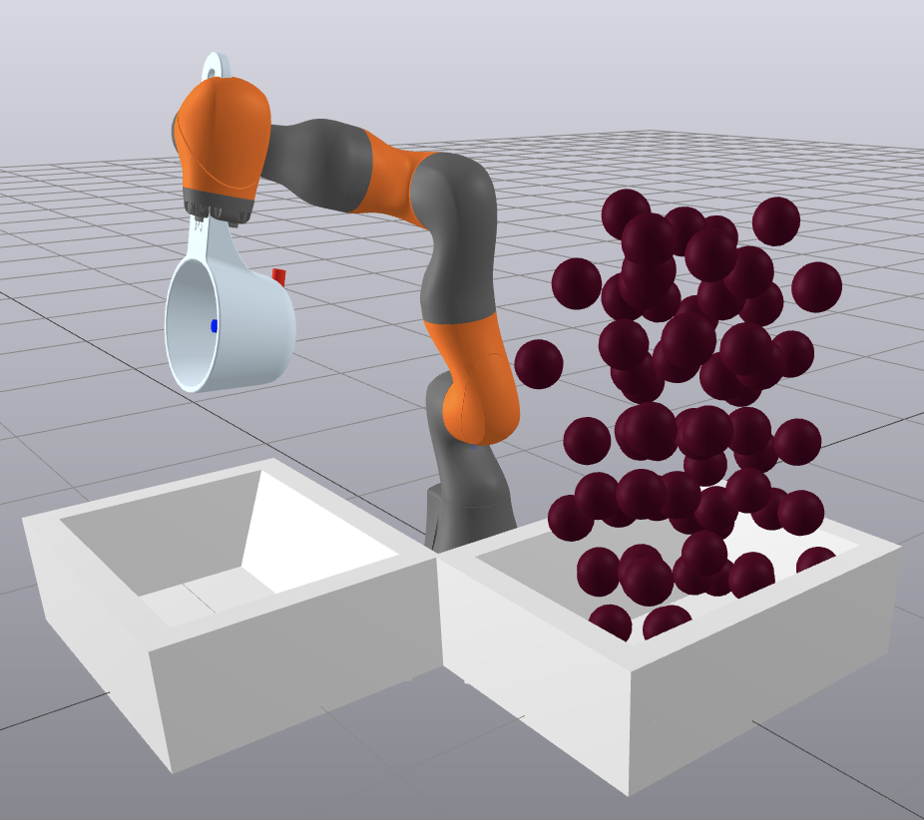
Scooping Environment
similar to bin picking setup
measuring cup welded to iiwa
spheres > bricks for simpler collision geometry
key issue:
simulation speed O(n²)
Notes:
hann
Since our project requires importing a scooper object, we were surprised by the difficulty of setting up the \texttt{package.xml} and other boilerplate necessary to import it into the simulation. It ended up being simple to put in, but we couldn't figure it out on our own before asking for help.
updating to use the SAP contact solver, which is faster than the default meshcat contact solver, we found that increasing the number of objects getting scooped slowed down the simulation significantly, such that it could take nearly 10 minutes with 50 spheres to simulate just one or two scoops. This became a pretty strong constraint for how we thought about the granularity of poses in a single trajectory--too few poses, and the arm would not be able to fully execute a scoop; too many poses, and the simulation would take unreasonably long

Slide 6
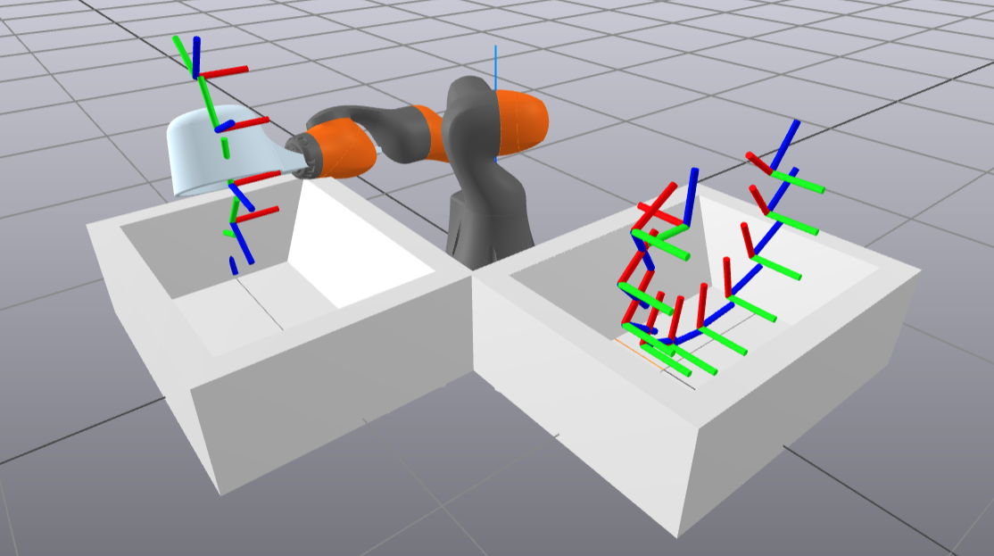
Geometric Scooping
Scoop:
bin constraint
elliptical path
Pour:
less constrained
circular path
Notes:
FIONA
adapted robot painter notebook
use simple geometry to plan trajectories
scoop:
started with circle, but hard to balance getting deep in the bin and being able to turn the scoop upright at the end
ellipse helped wit this balance
pour
less constrained since starting above the bin, so circular was sufficient

Slide 7
Teleop Record
Rationale: Easy to create trajectories for reuse
Steps:
Recording
Playback
Notes:
Martin

Slide 8
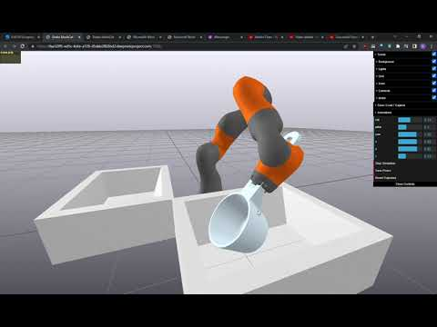
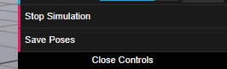
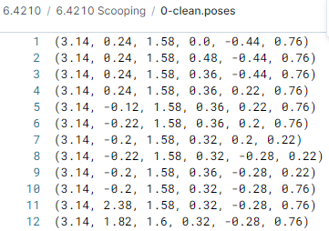
Teleop Record: Recording
Notes:
Martin

Slide 9
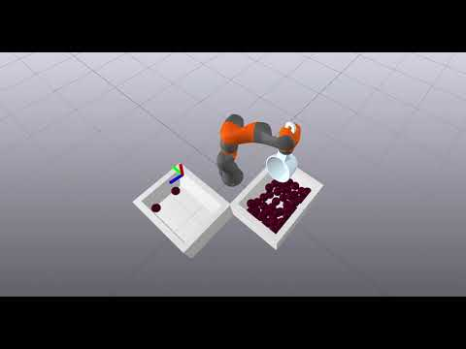
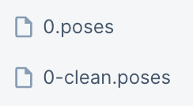
Teleop Record: Playback
Clean
Read
Parsing the file into usable object
Play
Notes:
Hann
The main components to using the teleop record for future automatic playback are in cleaning up the teleop path, reading the files they're stored in, and actually moving the iiwa arm based on the information read. A single trajectory file will usually hold an ordered list of desired poses for the iiwa. Often there are more than a few unnecessary movements in a single file, and so (barring more robust write conditions) some manual cleaning is desired to create smoother trajectories. In addition, deleting and adjusting poses can help with resolving issues from the iiwa getting “stuck” or having joints that are fully extended. The files are parsed to create paths based on movements between poses, rather than the positions themselves. The iiwa can then be directed to execute these movements, whether it is just once or on loop.

Slide 10
Results
Notes:
Fiona

Slide 11

Full Scoop
Notes:
FIONA
video of geometric scoop and pour
sped up 5x
big slowdown when scoop first interacts with spheres
tends to push some spheres out, but reliably picks up 3
scoop:
elliptical instead of circular path
ellipse had better balance of deep scoop but also having time to turn the scoop up at the end
after scoop, intermediate frame to keep the scoop upright
pour
not constrained like scoop was, circular was fine
key things to make it work:
scoop in controller plant
add “cup” frame to scoop sdf

Slide 12
Hurdles and Helps
Notes:
Martin

Slide 13
Encapsulation and Helper Functions
Model Directives
SlidersMemory
Notes:
Martin

Slide 14
Future Work
Scoop environment changes
Automatic trajectory selection through perception
Trajectory optimization
Might involve using a state machine/behavior tree
Cost function for scoops
we often lost spheres
scooping until a certain quantity is scooped
Improving simulation speed?
Notes:
martin

Slide 15
Thanks!

